Slide 1
Help Wanted Online A real-time measure of job postings
January 2022
Office of Research Connecticut Department of Labor
Connecticut Department of Labor – Research Office 200 Folly Brook Blvd. Wethersfield, CT 06109
Help Wanted Online

Slide 2
What is HWOL?
The Conference Board Help Wanted Online® Data Series (HWOL) measures the number of new, first-time Online job postings and jobs reposted from the previous month for over 50,000 Internet job boards, corporate boards and smaller job sites that serve niche markets and smaller geographic areas.
Connecticut Department of Labor – Research Office 200 Folly Brook Blvd. Wethersfield, CT 06109
Help Wanted Online

Slide 3
Upcoming Release Dates
Monthly Report: Friday, February 18th, 2022 Weekly New Ads Report: Updated every Friday
Connecticut Department of Labor – Research Office 200 Folly Brook Blvd. Wethersfield, CT 06109
Help Wanted Online

Slide 4
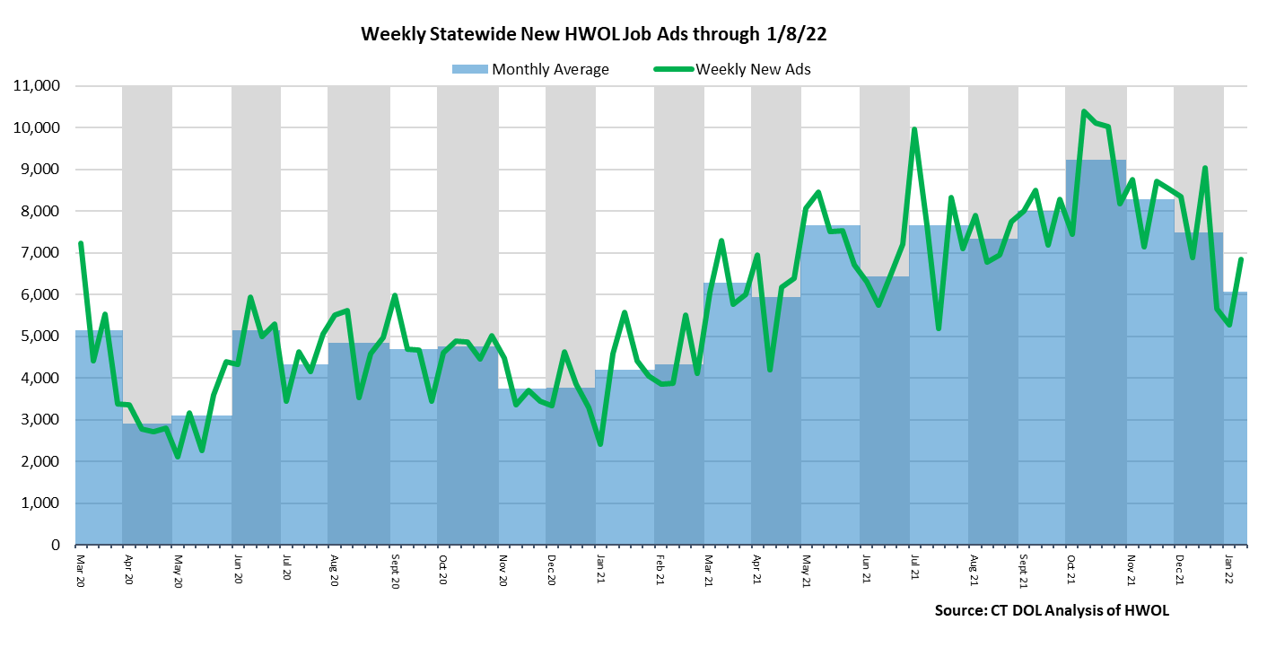
Statewide Weekly New Job Ads
Weekly New job postings was 6,853 during the week ending 1/08/22.
Connecticut Department of Labor – Research Office 200 Folly Brook Blvd. Wethersfield, CT 06109
Help Wanted Online

Slide 5
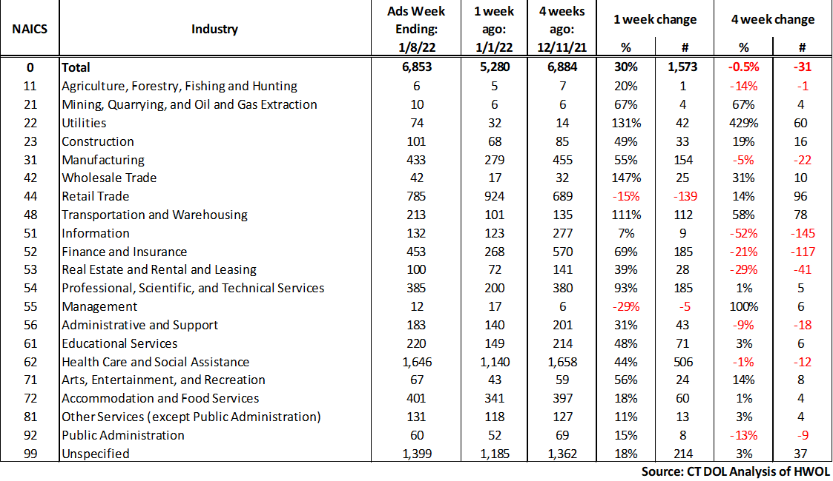
HWOL New Weekly Industry Job Ads – CT Statewide
Connecticut Department of Labor – Research Office 200 Folly Brook Blvd. Wethersfield, CT 06109
Help Wanted Online

Slide 6
Connecticut Department of Labor – Research Office 200 Folly Brook Blvd. Wethersfield, CT 06109
Help Wanted Online

Slide 7
Employers with the Most New Job Postings
Connecticut Department of Labor – Research Office 200 Folly Brook Blvd. Wethersfield, CT 06109
Help Wanted Online

Slide 8
Monthly HWOL Information
The following pages contain HWOL monthly data for December 2021. Monthly and weekly job ad information can be found here: https://www1.ctdol.state.ct.us/lmi/HWOL.asp
Connecticut Department of Labor – Research Office 200 Folly Brook Blvd. Wethersfield, CT 06109
Help Wanted Online

Slide 9
Statewide Highlights
- Total postings in Connecticut was 96,597 in December 2021. -Industry sectors with the most job postings were Health Care and Social Assistance (21,685 postings), Retail Trade (12,499 postings), Finance and Insurance (7,549 posting), and Manufacturing (6,397 postings).
-Occupations with the most postings were Registered Nurses (6,248 postings), Retail Salespersons (3,308 postings), Laborers, Freight, & Material Movers (3,113 postings), Wholesale & Manufacturing Sales Representatives (2,451 postings), and Supervisors of Retail Sales Workers (1884 postings).
Connecticut Department of Labor – Research Office 200 Folly Brook Blvd. Wethersfield, CT 06109
Help Wanted Online

Slide 10
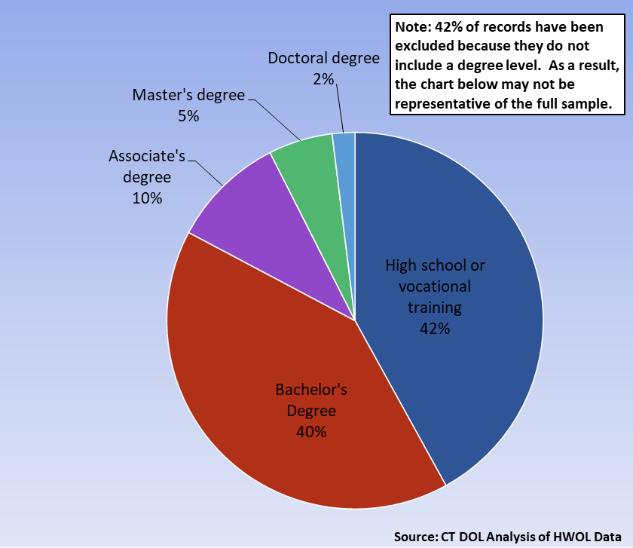
Connecticut Job Ads by Educational Requirements
Connecticut Department of Labor – Research Office 200 Folly Brook Blvd. Wethersfield, CT 06109
Help Wanted Online

Slide 11
Top Certifications in Connecticut Job Ads
Connecticut Department of Labor – Research Office 200 Folly Brook Blvd. Wethersfield, CT 06109
Help Wanted Online

Slide 12
Top Skills in Connecticut Job Ads
Connecticut Department of Labor – Research Office 200 Folly Brook Blvd. Wethersfield, CT 06109
Help Wanted Online

Slide 13
Top Skills by Industry in Connecticut Job Ads
Connecticut Department of Labor – Research Office 200 Folly Brook Blvd. Wethersfield, CT 06109
Help Wanted Online

Slide 14
Top Skills by Industry in Connecticut Job Ads (Continued)
Connecticut Department of Labor – Research Office 200 Folly Brook Blvd. Wethersfield, CT 06109
Help Wanted Online

Slide 15
Connecticut Department of Labor – Research Office 200 Folly Brook Blvd. Wethersfield, CT 06109
Help Wanted Online

Slide 16
Connecticut Employers with the Most Job Ads
Connecticut Department of Labor – Research Office 200 Folly Brook Blvd. Wethersfield, CT 06109
Help Wanted Online

Slide 17
Connecticut Occupations with the Most Job Ads
Connecticut Department of Labor – Research Office 200 Folly Brook Blvd. Wethersfield, CT 06109
Help Wanted Online

Slide 18
Connecticut Job Ads by Industry and Major Occupational Group
Connecticut Department of Labor – Research Office 200 Folly Brook Blvd. Wethersfield, CT 06109
Help Wanted Online

Slide 19
Workforce Area Data
Workforce Area Highlights
Job Ads by Industry
Job Ads by Location
Employers With The Most Job Ads
Occupations With The Most Job Ads
Connecticut Department of Labor – Research Office 200 Folly Brook Blvd. Wethersfield, CT 06109
Help Wanted Online

Slide 20
Workforce Area Highlights
Connecticut Department of Labor – Research Office 200 Folly Brook Blvd. Wethersfield, CT 06109
Help Wanted Online

Slide 21
Connecticut Department of Labor – Research Office 200 Folly Brook Blvd. Wethersfield, CT 06109
Help Wanted Online

Slide 22
Eastern Workforce Job Ads by Location
Connecticut Department of Labor – Research Office 200 Folly Brook Blvd. Wethersfield, CT 06109
Help Wanted Online

Slide 23
Eastern Workforce Employers
with the Most Job Ads
General Dynamics
Pfizer
Norwich Public Schools
Mohegan Sun
Windham Hospital
Masonicare Corporation
Natchaug Hospital Incorporated
Trinity Health
Generations Family Health Center
UnitedHealth Group
Bob's Discount Furniture
Sonalysts Incorporated
The Home Depot Incorporated
Universal Health Services, Inc.
Aveanna Healthcare
Nordson Corporation
CVS Health
Staples
Page Taft Compass
University of Connecticut
Yale-New Haven Health System
Day Kimball Healthcare
William W. Backus Hospital
Amazon
FM Global
State of Connecticut
Lowe's Companies, Inc
Walgreens Boots Alliance Inc
Charles River Laboratories
Compass Group North America
United Parcel Service Incorporated
US Foods
BJ's Wholesale Club, Inc.
Mashantucket Pequot Gaming
Petco
Thames Valley Council For Community Action
Anthem Blue Cross
Citizens Financial Group
Connecticut Department of Labor – Research Office 200 Folly Brook Blvd. Wethersfield, CT 06109
Help Wanted Online

Slide 24
Eastern Workforce Occupations
with the Most Job Ads
Connecticut Department of Labor – Research Office 200 Folly Brook Blvd. Wethersfield, CT 06109
Help Wanted Online

Slide 25
Connecticut Department of Labor – Research Office 200 Folly Brook Blvd. Wethersfield, CT 06109
Help Wanted Online
25

Slide 26
North Central WDA Job Ads by Location
Connecticut Department of Labor – Research Office 200 Folly Brook Blvd. Wethersfield, CT 06109
Help Wanted Online

Slide 27
North Central WDA Employers
with the Most Job Ads
Hartford Healthcare
Raytheon
Trinity Health
Allied Universal
Accenture
Travelers
CVS Health
The Hartford Financial Group
United Parcel Service Incorporated
Walgreens Boots Alliance Inc
Stanley Black & Decker
Boston Market
Carvana LLC
Pearson
Sysco Corporation
Laboratory Corporation of America
Genesis Healthcare Corporation
PricewaterhouseCoopers
EverSource
Amazon
UnitedHealth Group
Cigna Corporation
State of Connecticut
Aya Healthcare
Connecticut Children's Medical Center
Wheeler Clinic
Hartford Public Schools
Disney
FedEx
Eastern Connecticut Health Network
The Home Depot Incorporated
Verizon Communications Incorporated
University of Connecticut
KPMG
Nelnet
Lowe's Companies, Inc
Advance Auto Parts Incorporated
Certified Mobile Notary Service
Connecticut Department of Labor – Research Office 200 Folly Brook Blvd. Wethersfield, CT 06109
Help Wanted Online

Slide 28
North Central WDA Occupations
with the Most Job Ads
Connecticut Department of Labor – Research Office 200 Folly Brook Blvd. Wethersfield, CT 06109
Help Wanted Online

Slide 29
Connecticut Department of Labor – Research Office 200 Folly Brook Blvd. Wethersfield, CT 06109
Help Wanted Online

Slide 30
Northwest WDA Job Ads by Location
Connecticut Department of Labor – Research Office 200 Folly Brook Blvd. Wethersfield, CT 06109
Help Wanted Online

Slide 31
Northwest WDA Employers
with the Most Job Ads
Hartford Healthcare
Nuvance Health
Waterbury Hospital
Aya Healthcare
Intuit
State of Connecticut
Carvana LLC
Benchmark Senior Living
Charlotte Hungerford Hospital
Seasons Hospice & Palliative Care
CVS Health
AutoZone Auto Parts
Lowe's Companies, Inc
Restaurant Depot
Anthem Blue Cross
Quest Diagnostics Incorporated
Allied Universal
Naugatuck Public Schools
Careone
Amazon
Boehringer Ingelheim
Trinity Health
United Parcel Service Incorporated
Post University
UnitedHealth Group
The Home Depot Incorporated
Verizon Communications Incorporated
Fuelcell Energy Inc
Petco
Walgreens Boots Alliance Inc
BJ's Wholesale Club, Inc.
Whole Foods Market, Inc.
Compass Group North America
Realogy Franchise Group LLC
Starbucks Coffee Company
Danbury Public Schools
LHC Group
Veritiv Corp
Connecticut Department of Labor – Research Office 200 Folly Brook Blvd. Wethersfield, CT 06109
Help Wanted Online

Slide 32
Northwest WDA Occupations
with the Most Job Ads
Connecticut Department of Labor – Research Office 200 Folly Brook Blvd. Wethersfield, CT 06109
Help Wanted Online

Slide 33
Connecticut Department of Labor – Research Office 200 Folly Brook Blvd. Wethersfield, CT 06109
Help Wanted Online

Slide 34
South Central WDA Job Ads by Location
Connecticut Department of Labor – Research Office 200 Folly Brook Blvd. Wethersfield, CT 06109
Help Wanted Online

Slide 35
South Central WDA Employers
with the Most Job Ads
Yale University
Anthem Blue Cross
Avangrid
Verizon Communications Incorporated
Aya Healthcare
State of Connecticut
Walgreens Boots Alliance Inc
The Home Depot Incorporated
Lowe's Companies, Inc
Masonicare Corporation
Middlesex Health System Incorporated
Page Taft Compass
Department of Veterans Affairs
Petco
Quinnipiac University
Pratt & Whitney
A R Mazzotta Employment
Honeywell
Totalmed Incorporated
Amazon
Yale-New Haven Health System
Hartford Healthcare
Medtronic
United Parcel Service Incorporated
Community Health Center, Inc.
Allied Universal
UnitedHealth Group
Genesis Healthcare Corporation
Alexion Pharmaceuticals
AutoZone Auto Parts
Gaylord Specialty Healthcare & Hospital
Seasons Hospice & Palliative Care
FedEx
Southern Connecticut State University
Advantage Sales & Marketing
O'Reilly Automotive Inc
University of New Haven
CVS Health
Connecticut Department of Labor – Research Office 200 Folly Brook Blvd. Wethersfield, CT 06109
Help Wanted Online

Slide 36
South Central WDA Occupations
with the Most Job Ads
Connecticut Department of Labor – Research Office 200 Folly Brook Blvd. Wethersfield, CT 06109
Help Wanted Online

Slide 37
Connecticut Department of Labor – Research Office 200 Folly Brook Blvd. Wethersfield, CT 06109
Help Wanted Online

Slide 38
Southwest WDA Job Ads by Location
Connecticut Department of Labor – Research Office 200 Folly Brook Blvd. Wethersfield, CT 06109
Help Wanted Online

Slide 39
Southwest WDA Employers
with the Most Job Ads
Humana
St Vincent’s Medical Center
Aya Healthcare
Sema4
PricewaterhouseCoopers
United Parcel Service Incorporated
Compass Group North America
ASML
Rolls Royce Plc
Sacred Heart University
Deloitte
Verizon Communications Incorporated
Stamford Public Schools
Sunrise Senior Living, Inc.
Boston Market
UnitedHealth Group
Octagon
Michaels Arts and Crafts
Walgreens Boots Alliance Inc
Amazon
Yale-New Haven Health System
Charter Communications
Lockheed Martin Corporation
Allied Universal
Stamford Hospital
VMware Incorporated
KPMG
Norwalk Public School District
Whole Foods Market, Inc.
The Home Depot Incorporated
Capital One
Griffin Hospital
Totalmed Incorporated
Intuit
Griffin Health Services Corporation
Nordstrom
Advantage Sales & Marketing
World Wrestling Entertainment
Connecticut Department of Labor – Research Office 200 Folly Brook Blvd. Wethersfield, CT 06109
Help Wanted Online

Slide 40
Southwest WDA Occupations
with the Most Job Ads
Connecticut Department of Labor – Research Office 200 Folly Brook Blvd. Wethersfield, CT 06109
Help Wanted Online

Slide 41
All advertisement data used in this publication is from the Conference Board’s Help Wanted Online data series.
For more information or data requests, contact Matthew Krzyzek in the Office of Research at the Department of Labor.
Matthew.Krzyzek@ct.gov
For more Connecticut Labor Market Information visit:
www.ctdol.state.ct.us/lmi
https://www.facebook.com/ctlmi
Twitter: @DOL_Research
Connecticut Department of Labor – Research Office 200 Folly Brook Blvd. Wethersfield, CT 06109
Help Wanted Online

